Slide 1

WORKSHOP
Survey
Introduction to Data Analysis and Machine Learning
MLearning
Reviews
Analysis
Term
Muhammad Usama Arain

Slide 2
What is Data Analysis
Data Analysis is a process of collecting, transforming, cleaning, and modeling data with the goal of discovering the required information. The results so obtained are communicated, suggesting conclusions, and supporting decision-making.
Reviews
Survey
Analysis
M.Learning
Term

Slide 3
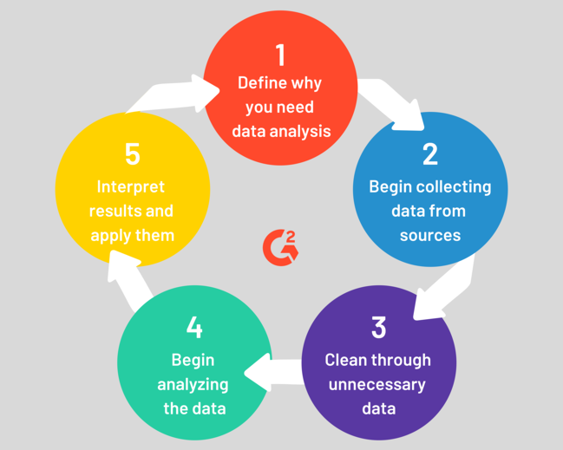
Survey
M.Learning
Reviews
Analysis
Term

Slide 4

Statistics
Statistics is the discipline that concerns the collection, organization, analysis, interpretation and presentation of data. In applying statistics to a scientific, industrial, or social problem,
Survey
M.Learning
Reviews
Analysis
Term

Slide 5
Statistics Types
1) Descriptive Statistics
2) Inferential Statistics
Descriptive statistics are brief description that summarize a given data set, which can be either a representation of the entire or a sample of a population. [ Measure of Center and Variability ]
Statistical inference is the process of using data analysis to deduce properties of an underlying probability distribution.for example by testing hypotheses and deriving estimates.
Reviews
Survey
Analysis
M.Learning
Term

Slide 6
Descriptive Statistics
Measures of Center (single number summary)
Mean, Median,Mode
Survey
M.Learning
Average CGPA in Software Dept
Individual average spending on cloth in Hyderabad
Reviews
Analysis
Term
Measures of Dispersion
Standard Deviation, Variance
To measure one's popularity on Facebook ?

Slide 7
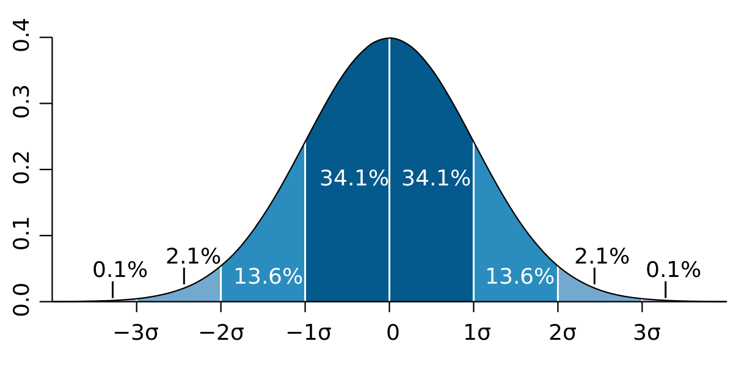
Descriptive Statistics...
Reviews
Survey
Analysis
M.Learning
Term
Distribution Graph

Slide 8
Descriptive Statistics...
TASK # 01
The owner of the restaurant wants to find out more about from where his patrons are
comming from. One day he decided to gather data about the distance (in miles)
that people commuted to get to his restaurant. People reported the following
distances traveled:
14,16,3,2,4,15,11,8,1,7,2,1,3,4,10,22,20
He wants to create a graph that helps him to understand the spread of distance
(and the mean distance that people travel. What kind of graph should be created?)
Survey
M.Learning
Reviews
Analysis
Term

Slide 9
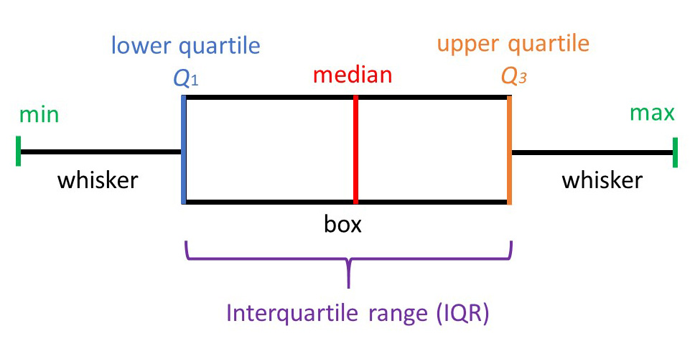
Descriptive Statistics...
Five Number Summary
Survey
M.Learning
Reviews
Analysis
Term

Slide 10

Experiment Study
Observational
Study
Reviews
Learning
Analysis
Term
WHICH ONE TO CHOOSE
WHICH ONE TO CHOOSE
Show Causation
Show Relationship

Slide 11

Golden Arches theory of conflict prevention
“No two countries with McDonald’s in them will ever go to war”
Guys what do you think Does this theory holds TRUE ?
Learning
Survey
Reviews
Analysis
Term

Slide 12

Trade > Surplus > Better Life
Example
Dubai and India over Kashmir issue
India and America over Kashmir issue
Learning
Survey
Reviews
Analysis
Term

Slide 13
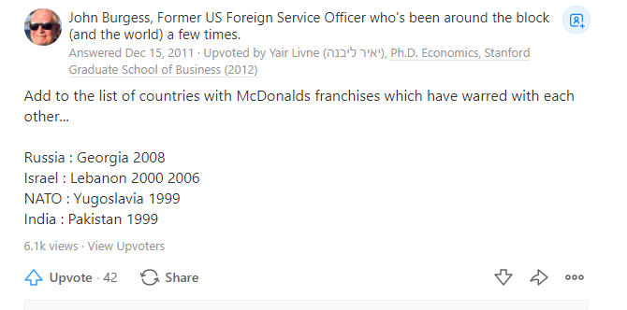
Learning
Survey
Reviews
Analysis
Term
Confusion ?

Slide 14
Coorelation does not mean Causation !
Learning
Survey
Reviews
Analysis
Term

Slide 15
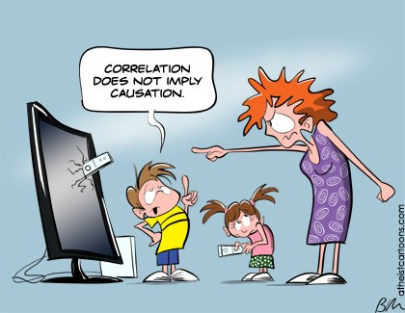
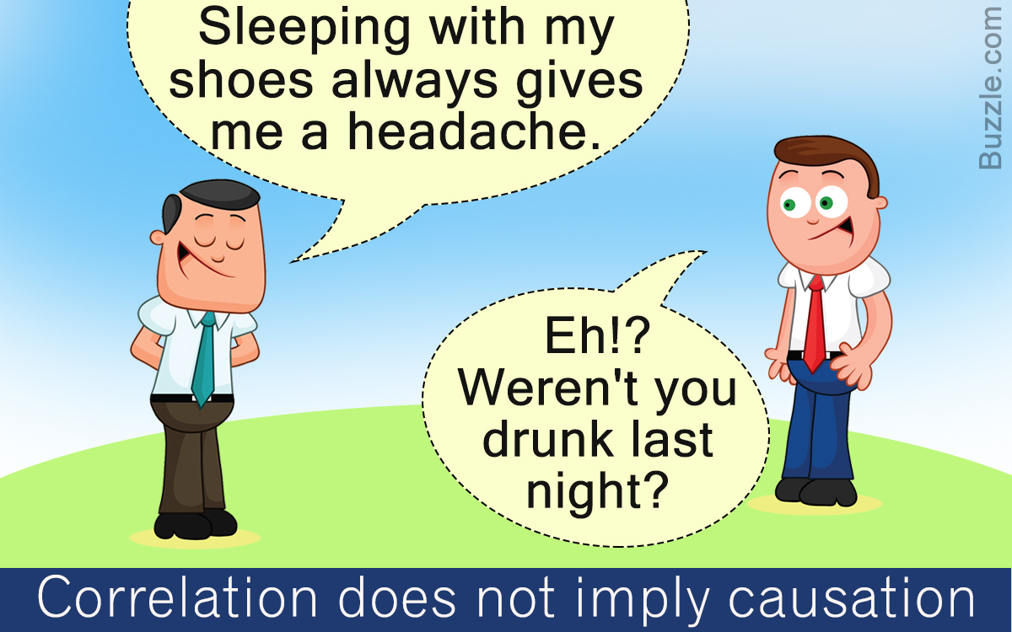
Coorelation > Less info: Can't see undercovers
Causation > More info : Transparent things
Learning
Survey
Reviews
Analysis
Term

Slide 16
Why Graphs are Important
Match Report | Scores
1st Over | 6
2nd Over | 8
3rd Over | 15
4th Over | 19
5th Over | 25
Learning
Survey
Reviews
Analysis
Term

Slide 17
Why Graphs are Important...
Overs | Score A | Score B
1st | 6 | 4
2nd | 8 | 10
3rd | 15 | 12
4th | 19 | 17
5th | 25 | 20
Learning
Survey
Term
Reviews
Analysis
Overs | Scores
1st | 6
2nd | 2
3rd | 7
4th | 4
5th | 6

Slide 18
Let's Conduct Survey....
Learning
Term
Reviews
Analysis
https://github.com/Muhammad-Usama-Arain/Data-Analysis-Workshop

Slide 19
Data Collection
Analyzing Data
Data Wrangling
Train and Test
Check Accuray
M.Learning
Survey
Reviews
Analysis
Term

Slide 20
Data Collection
Major sourcrse of Data
Files
Databases (SQL & NoSQL)
API
M.Learning
Survey
Reviews
Analysis
Term

Slide 21
Reviews
So Far We Learn !
history
Analysis
about
M.Learning

Slide 22

Finally Reviews Form
Survey
MLearning
Reviews
Analysis
Term
<><><><><> Workshop Reviews <><><><><><>

Slide 23
THANK YOU

